Slide 1
Brain Tumor Detection CNN
By Britney Nguyen, Andrew Bender, George Zavala, Abhiram Borra, and Arnav Kaushik

Slide 2
Contents
Introduction
Objectives
Background
Brain Tumors
Importance of our Model
Methodology
Imports and Data Processing
CNN Model I
Hyperparameter Tuning
Final Model
Results
Performance of CNN Model I
Performance of Final Model
Discussion
Conclusion

Slide 3
Introduction

Slide 4
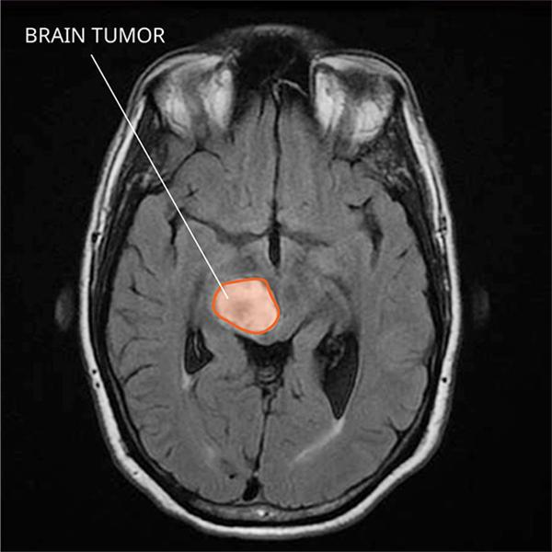
Objectives
The objective of this project was to build a machine learning model that uses computer vision to classify brain MRI scans for brain tumor detection.
The goal was to learn how to build a Convolutional Neural Network that would provide the team with a basic understanding of the applications of artificial intelligence in healthcare.
This model can help to speed up the process of tumor detection in MRI scans.
Throughout the process of developing this project, the goal to learn about working with data, and how to design and optimize a Convolutional Neural Network was accomplished.
https://www.cancer.gov/rare-brain-spine-tumor/tumors/diffuse-midline-gliomas

Slide 5
Background

Slide 6
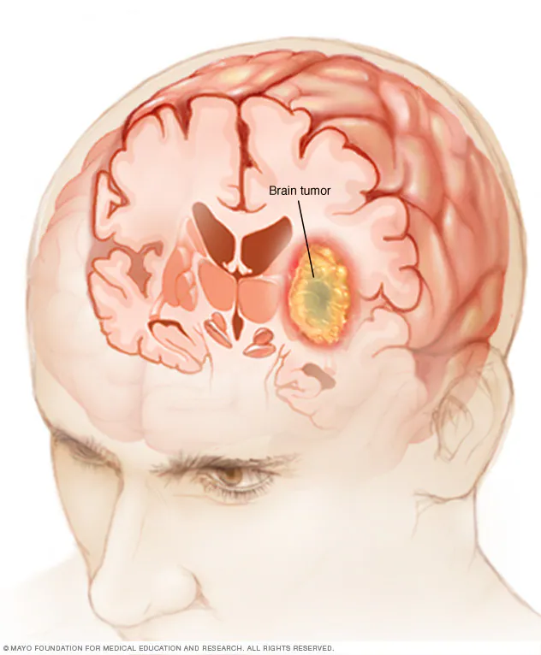
Brain Tumors
A Brain Tumor is a growth of cells in the brain or near it
Brain Tumors can be either benign or malignant
Malignant tumors are what we call “Brain Cancer”
Malignant tumors can grow rapidly and destroy brain tissue
At present, a staggering 1 million people in the United States are living with a Brain Tumor
Out of these, 72% are supposed to be benign, and the remaining 28% are malignant
The relative survival rate for people living with malignant tumors is only 35.7%
About 18,990 will die from a malignant brain tumor in 2023
https://www.mayoclinic.org/diseases-conditions/brain-tumor/symptoms-causes/syc-20350084

Slide 7
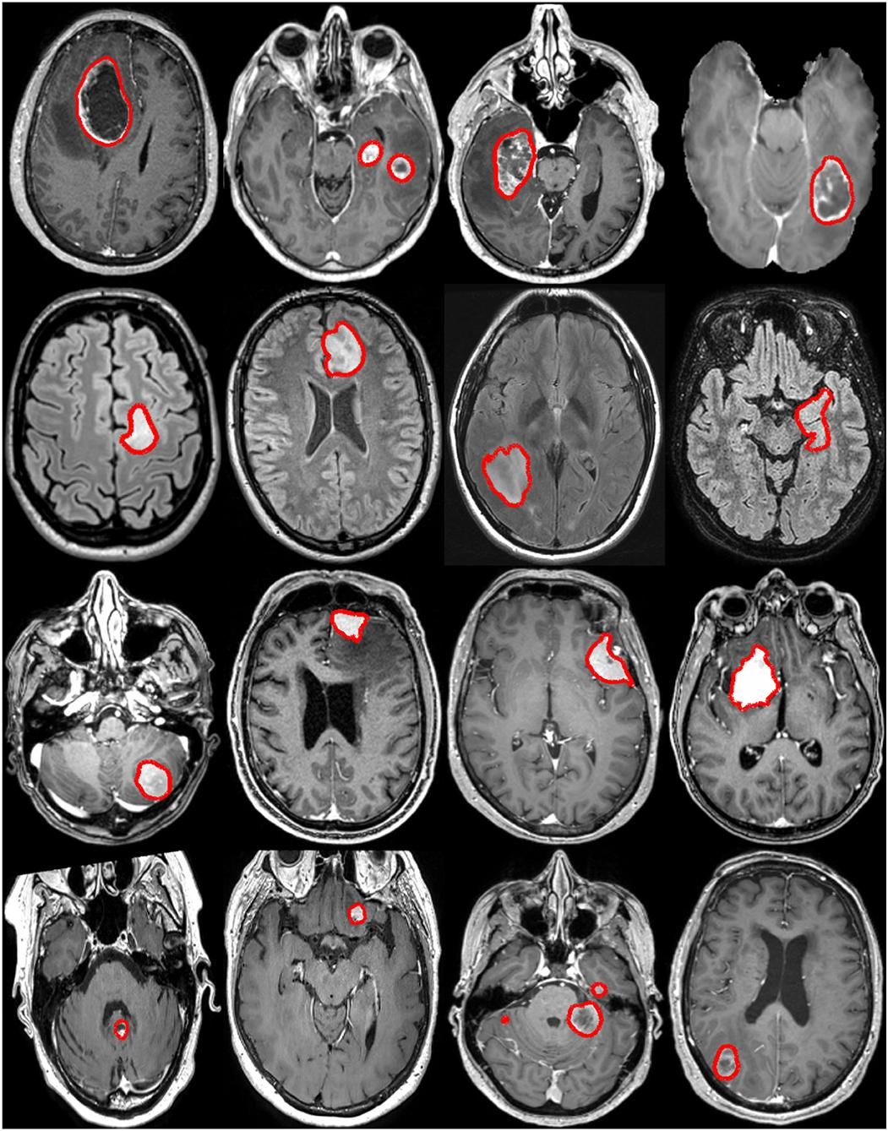
Importance of Our Model
Brain Cancer is estimated to be the 10th leading cause of death by cancer in 2023 across sexes and ages
Models like ours can extract quantitative information from diagnostic images, including complex patterns that can be extremely difficult for the human eye to detect or quantify
Through the intersection of machine learning and biomedical imaging for oncology, we can create better and personalized medicine measures for patients in need
https://www.frontiersin.org/articles/10.3389/fneur.2022.932219/full
https://www.mayoclinic.org/diseases-conditions/brain-tumor/symptoms-causes/syc-20350084

Slide 8
Methodology

Slide 9
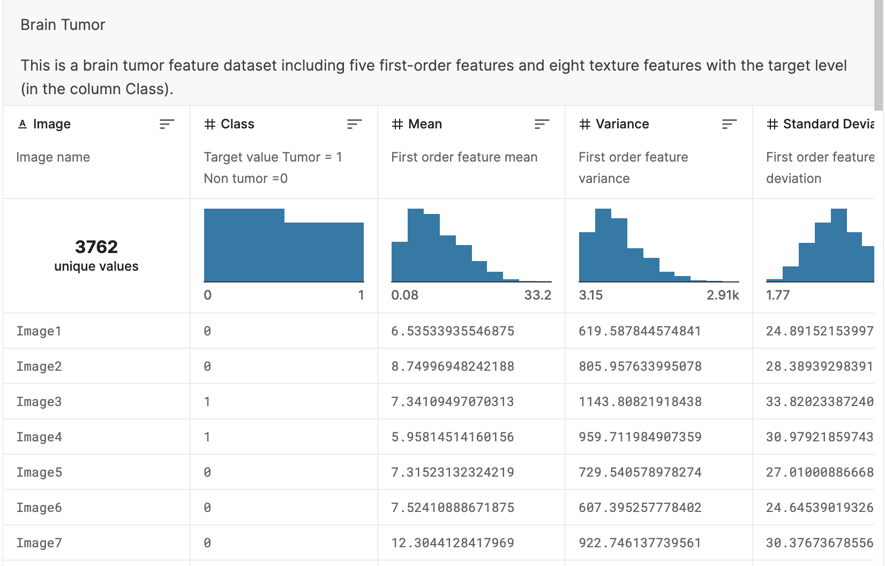
Dataset
The dataset titled “Brain Tumor” was taken from the website Kaggle
The dataset used was created by Jakesh Bohaju. The DOI citation for the dataset is 10.34740/kaggle/dsv/1370629.
There are 3762 images from Brats2015 brain tumor with different MRI slices of the brain.
A file titled BrainTumor.csv includes information about the images, mentioning five first-order features and eight texture features with the target level.

Slide 10
library
imports
1. numpy
2. tensorflow
3. seaborn
4. pandas
5. Matplotlib
6. Os
7. cv2

Slide 11
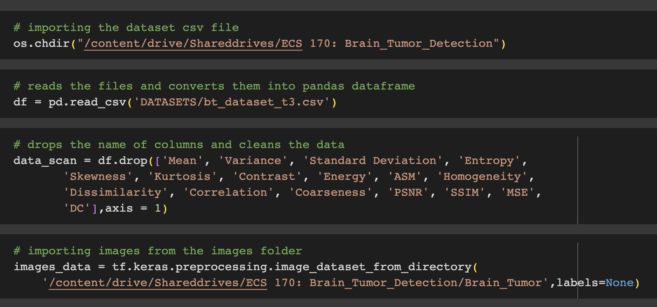
Data Preprocessing
After importing the data into Google Colab, the labeling columns from the BrainTumor.csv file were dropped so data could be cleaned to be used accurately
The brain scan images were put into the array images data using Keras.

Slide 12
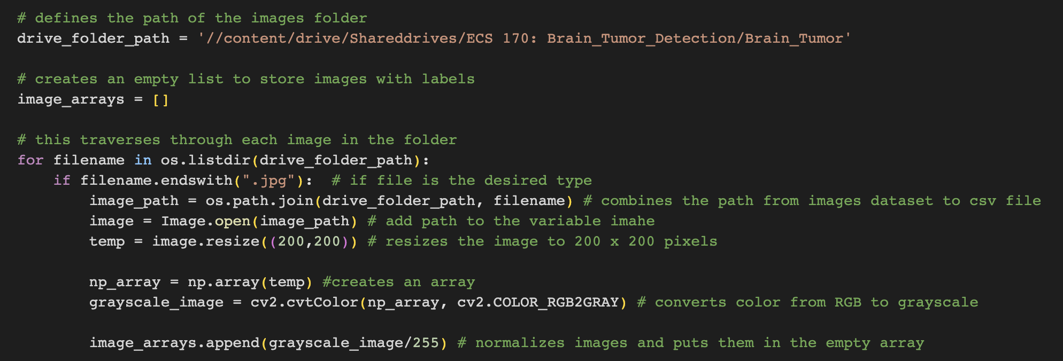
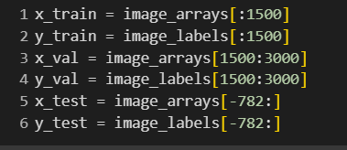
Data processing
Labels from the ’Class’ column were stored into a numpy array to perform data manipulations
The images were added to a numpy array in sorted order so it would correspond to the labels
Every image was stored in image arrays and was represented with the numbers 0 (color black) or 1 (color white)
Finally, brain scan data and its classification data was split into training (1500 items) , validation (1500 items) , and test (782 items) sets

Slide 13
Building our Models
We built 2 models for this project
CNN Model I
Final Model

Slide 14
CNN Model I
Input Layer: 2D convolutional layer, 16 filter, 3 x 3 window size, ReLU activation
2 x 2 Max Pooling Layer
2D convolutional layer, 32 filter, 3 x 3 window size, ReLU activation
2 x 2 Max Pooling Layer
2D convolutional layer, 16 filter, 3 x 3 window size, ReLU activation
2 x 2 Max Pooling Layer
Flatten Layer
1st Fully-Connected Layer, 256 nodes, ReLU activation
Output Layer: 2nd Fully-Connected Layer, 1 node, sigmoid activation

Slide 15
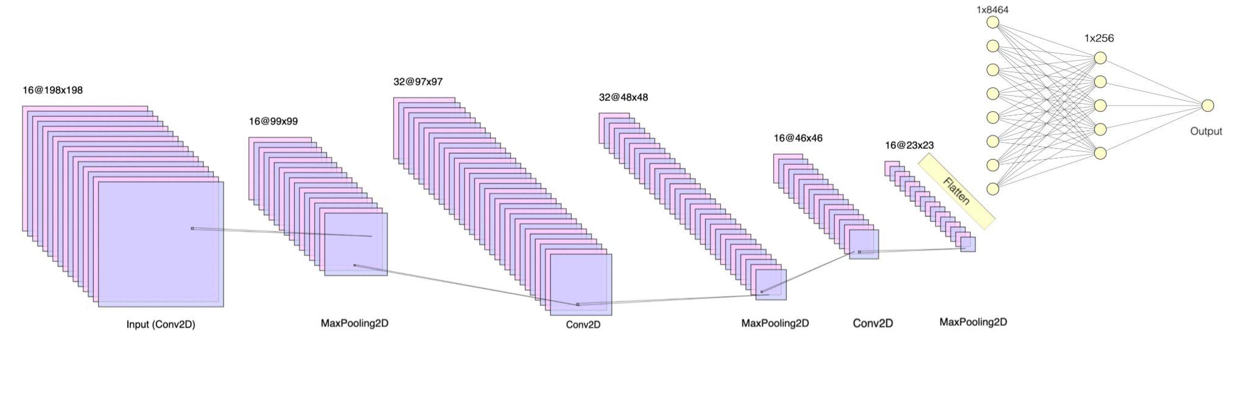
Figure: Visualization of CNN Model 1

Slide 16
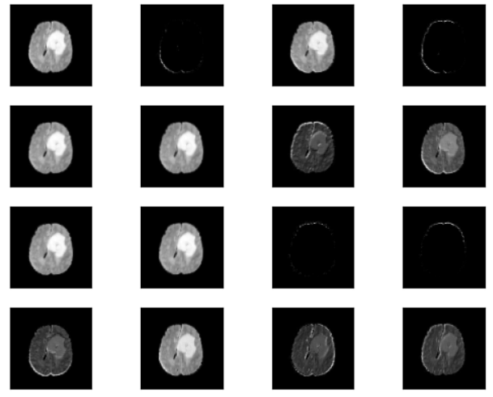
Figure: Visualization of an input image passing 16 filters in Hidden Layer I in CNN Model I

Slide 17
Final Model
Input Layer: 2D convolutional layer, 16 filter, 3 x 3 window size, ReLU activation
2 x 2 Max Pooling Layer
2D convolutional layer, 32 filter, 3 x 3 window size, ReLU activation
2 x 2 Max Pooling Layer
2D convolutional layer, 32 filter, 3 x 3 window size, ReLU activation
Flatten Layer
Output Layer: 2nd Fully-Connected Layer, 1 node, sigmoid activation

Slide 18
Hyperparameter Tuning Results for Final Model
These were taken to be the optimal hyperparameters after tuning:
Optimizer: Adam
Loss Function: Binary Cross Entropy
Hidden layers: 2
Nodes: 32
Activation functions: ReLu
Learning rate: 0.001

Slide 19
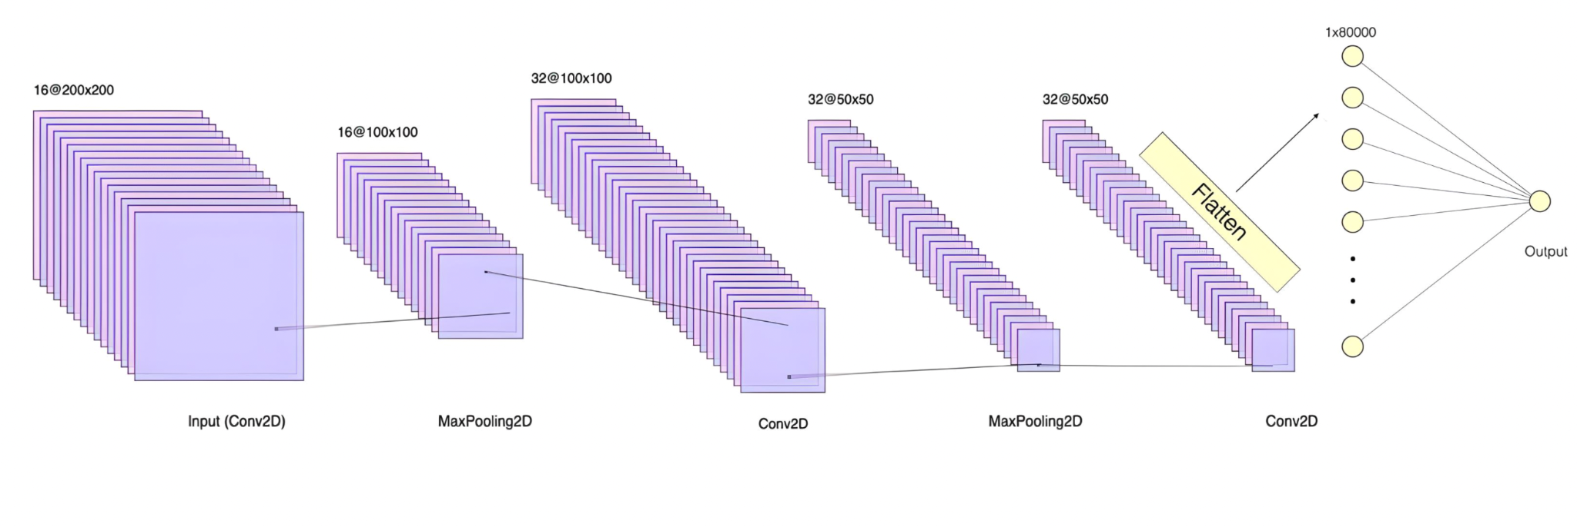
Figure: Visualization of the Final Model

Slide 20
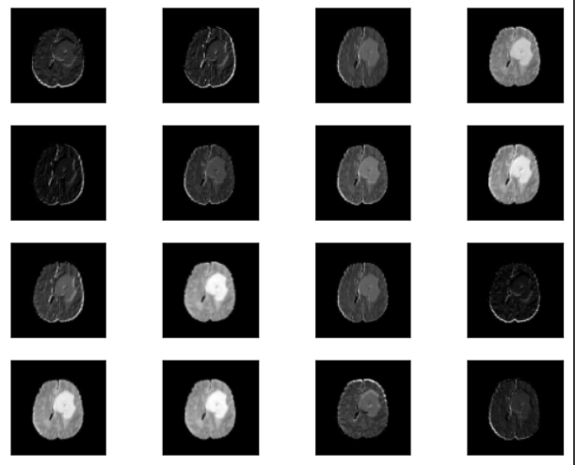
Figure: Visualization of an input image passing 16 filters in Hidden Layer I in the Final Model

Slide 21
Results

Slide 22
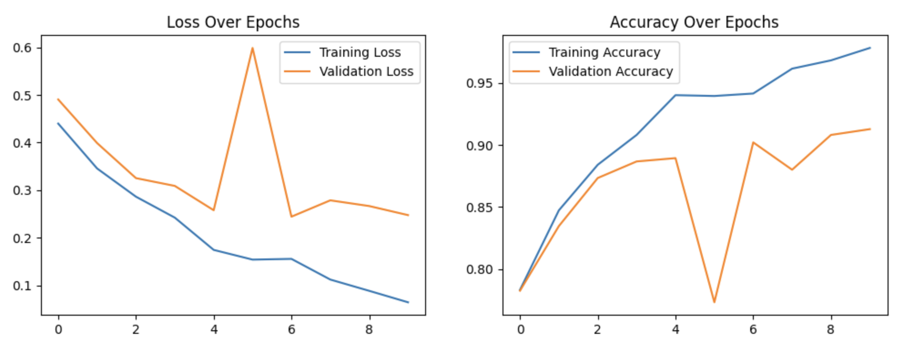
CNN Model 1
Training
Accuracy Rate: 96%
Loss Rate: 7.84%
Assessed with Validation Set
Accuracy Rate: 91.6%
Loss Rate: 23.36%
Testing
Accuracy Rate: 34.27%
Figure 7: Graphical Representation of Loss and Accuracy over Epochs for CNN Model 1

Slide 23
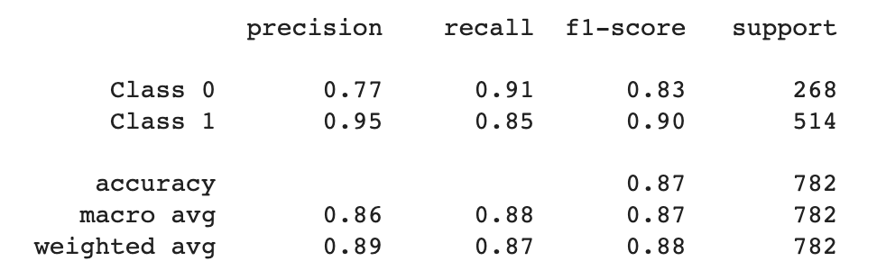
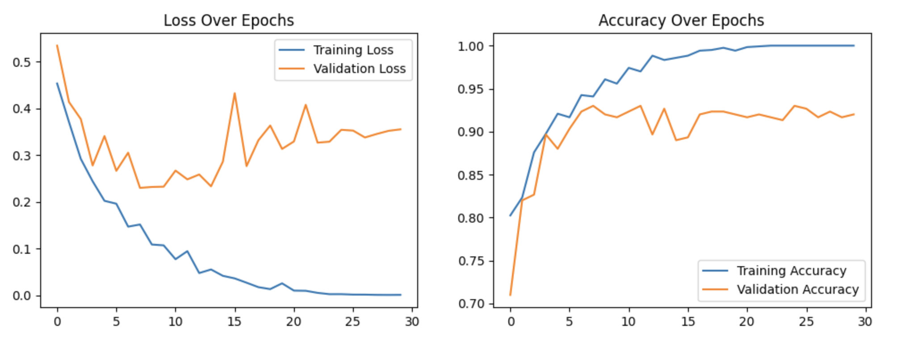
Final Model
Training
Accuracy Rate: 100%
Loss Rate: 0.0092%
Assessed with Validation Set
Accuracy Rate: 92.67%
Loss Rate: 0.2543%
Testing
Accuracy Rate: 87%
Figure 9: Visualization of the Classification Report for the Final Model.
Figure 8: Graphical Representation of Loss and Accuracy over Epochs for the Final Model.

Slide 24
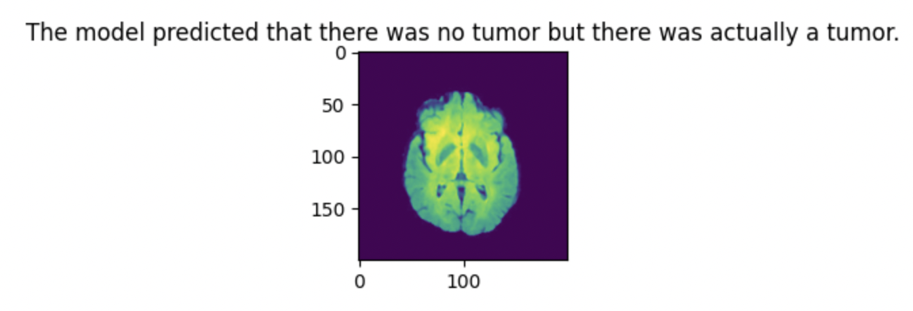
Discussion
The first CNN model that was constructed provided sub-optimal results; and hence, the methodology to approach building a CNN had to be altered.
A new model was built and then run and hyperparameters were tuned; this helped to create a better model with better rates of accuracy.
The model demonstrates high accuracy detecting brain tumors, it concurrently reflects a reduced accuracy in cases where tumors are absent.
Firstly, a false positive result may cause emotional distress for the patient and misguide medical professionals
A false positive is arguably preferable to a false negative
Given the consequences associated with missed diagnoses, maintaining the current model was deemed essential, even after the trade-off

Slide 25
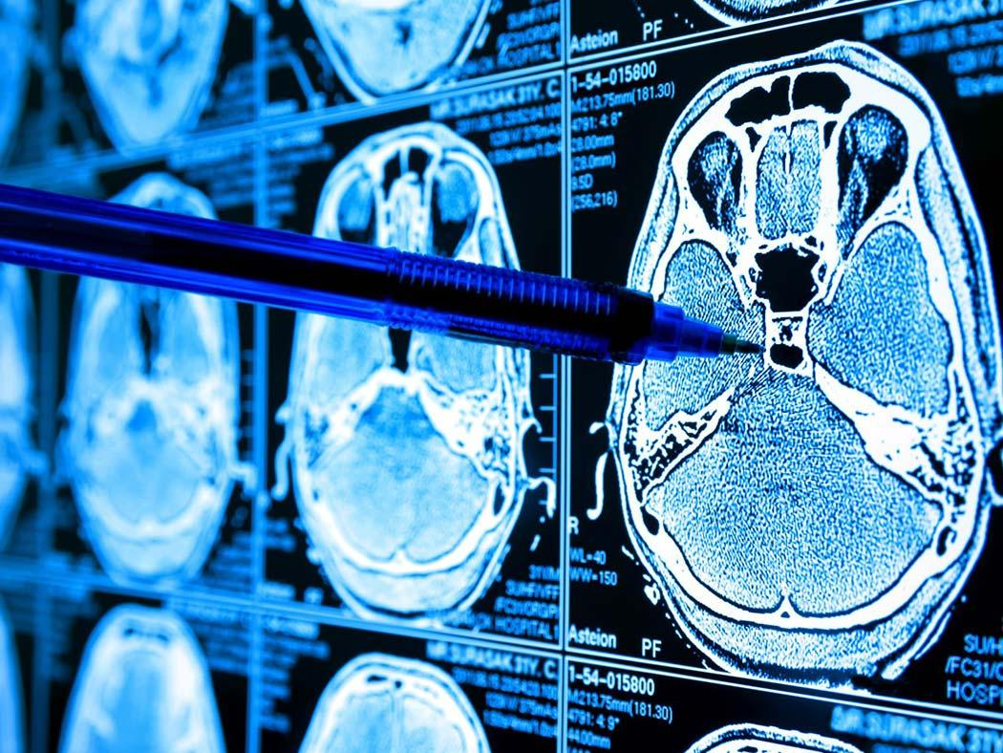
Conclusion
Constructing this model was a challenge, but our team was successfully able to implement a CNN model to predict the presence or absence of a brain tumor using images of MRI scans with considerable accuracy.
This model can be tuned and optimized to give outputs about different types of tumors with different features (varied location, size, and severity).
Can also be possibly used in the fields of healthcare if bigger dataset is used, However, we must proceed with caution while using machine learning in healthcare.
https://sciencemediahub.eu/2021/11/17/the-future-of-ai-in-medical-imaging/

Slide 26
thank you so much!
any questions?

